Slide 1
10 Keys Merger Success: A Leadership Conversation
Kimberley Sherwood
Founder and Principal Consultant

Slide 2
Today’s Conversation
Merger Building Blocks
10 Keys to a Successful Merger
Pitfalls to Watch Out For

Slide 3
This Topic Is Important To Me Because

Slide 4
4 Kinds of Merger

Slide 5
A Spectrum of Options
Trading
Pooling
Creating

Slide 6
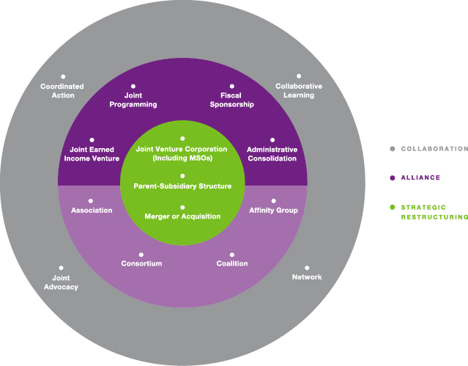
Framework

Slide 7
10 Keys to Success

Slide 8
Keys to Successful Merger
Trust
Mission, Mission, Mission
Clarity
Know Thyself and Your Counterpart
The CEO is Critical

Slide 9
Keys to Successful Merger
Board Chair + Board = merger advocates
Staff Involvement
Leaders Must Pay Attention to ALL 3 phases
Rely on Outside Experts
Participants Do Their Homework

Slide 10
Advice to Players
Board members
CEO/ED and Executive Staff
Funders

Slide 11
What will you do now?

Slide 12
Thank You! Join Our Community of Committed Practitioners
WWW.THIRDSECTORGROUP.COM

